Slide 1
Summary Presentation
Pizza Project

Slide 2
OVERVIEW
The repository holds an analytical report and interactive dashboard that breaks down a pizza store’s sales. It covers key revenues, category performance, orders over time and suggestable actions to boost sales and streamline operations.

Slide 3
Summary Presentation
Background | $817.86k revenue in management 21.35k orders in 2015 50k Pizzas sold Low credit losses
Key Findings | Most expensive Pizza Most ordered Pizza by category Pizza ordered over time Peak ordering hours Total and average revenue
Recommendation | Grow more revenue under management from $817.86k to $2M over a year Boost profile and raise visibility Highlight and push the most popular pizzas with stronger promotional efforts Schedule more staff to the peak period to boost efficiency and cut down on waiting

Slide 4
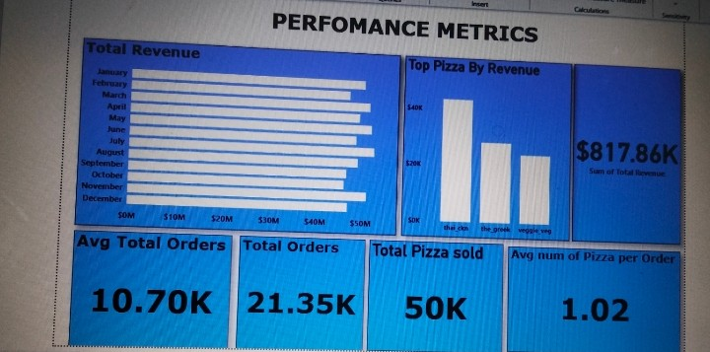
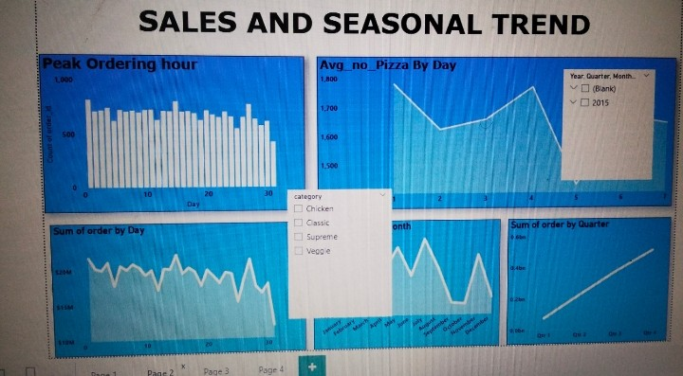
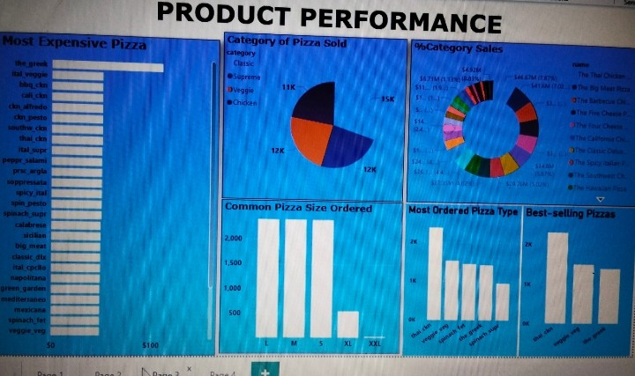
SCREENSHOT OF DASHBOARD

